Slide 1


Matthias Mueller
01/10/2023

Slide 2

Outline
Executive Summary
Introduction
Methodology
Results
Conclusion
Appendix

Slide 3
Executive Summary
Summary of methodologies
Data Collection with API
Data Collection with Web Scraping
Data Wrangling
Exploratory Data Analysis with SQL
Exploratory Data Analysis with Data Visualization
Visual Analytics with Folium
Machine Learning Prediction
Summary of all results
Exploratory Data Analysis
Interactive Analytics
Predictive Analytics

Slide 4
Introduction
Project background and context
SpaceX advertises Falcon 9 rocket launches on its website, with a cost of 62 million dollars; other providers cost upward of 165 million dollars each, much of the savings is because SpaceX can reuse the first stage. Therefore, if we can determine if the first stage will land, we can determine the cost of a launch. This information can be used if an alternate company wants to bid against SpaceX for a rocket launch.
Problems you want to find answers
Predict, if the Falcon 0 first stage will land successfully
Which factors determine if the rocket will land successfully

Slide 5

Section 1

Slide 6
Methodology
Executive Summary
Data collection methodology:
Data collection was done with the SpaceX API and web scraping
Perform data wrangling
One-hot encoding for categorial features and data cleansing was done
Perform exploratory data analysis (EDA) using visualization and SQL
Perform interactive visual analytics using Folium and Plotly Dash
Perform predictive analysis using classification models
How to build, tune, evaluate classification models

Slide 7
Data Collection
In the process of data collection several methods were used:
In the project we used the get request via the SpaceX API to collect data
In the next step, the response content was decoded as json-format and turned it into a pandas dataframe
Next the data was cleaned, missing values were removed or filled in with fitting values (like average)
The BeautifoulSoup framework was used for web scraping and get the Falcon 9 launch records from Wikipedia as a html table and pass it on to a pandas data frame

Slide 8
Data Collection – SpaceX API
Request data from SpaceX API
Filter Falcon 9 data
Cleanse data
The data was collected via the SpaceX API and converted to a data frame
See GitHub for the complete workflow: https://github.com/Code770/IBM-Data-Science-capstone-project/blob/75d213337e8340b7779444ce88b6b27dbcced603/Data%20Collection.ipynb

Slide 9
Data Collection - Scraping
Request Falcon 9 data from Wikipedia
Extract columns from the html-table
Create data frame from extracted data
Webscraping from Wikipedia for the Falcon 9 launch records was applied using the BeautifoulSoup framework
GitHub Url: https://github.com/Code770/IBM-Data-Science-capstone-project/blob/a3e5a70ed6bc5ce218899d5f518de3c65faa4aeb/Data%20Collection%20with%20Web%20Scraping.ipynb

Slide 10
Data Wrangling
EDA
Calculations for additional summaries
Creation of outcome label for landings
Exploratory Data Analysis (EDA) was used to discover the dataset
The summaries of the launches per site or the occurrences of mission outcome per orbit were calculated and a landing outcome label was added to the dataframe
GitHub Url: https://github.com/Code770/IBM-Data-Science-capstone-project/blob/b5af91369a83d4a3ef858a9878b5c51877502820/Exploratory%20Data%20Analysis%20Overview.ipynb

Slide 11
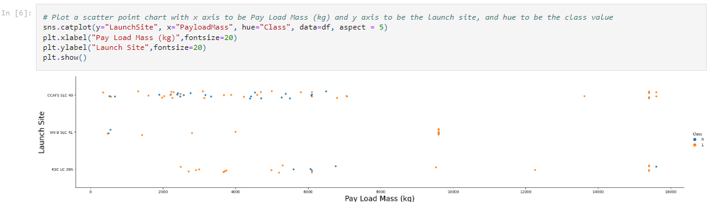
EDA with Data Visualization
For data exploration and to visualize relationships between features several graphs were used like barplots or scatterplots
Payload Mass vs flight number, launch site vs flight number, launch site vs payload mass, orbit vs flight number and payload vs orbit
GitHub Url: https://github.com/Code770/IBM-Data-Science-capstone-project/blob/9b6e45098fbea339f81602774b29d08bb9453358/EDA%20with%20Data%20Visualization.ipynb

Slide 12
EDA with SQL
SQL queries performed:
Display the names of the unique launch sites in the space mission
Display 5 records where launch sites begin with the string 'CCA’
Display the total payload mass carried by boosters launched by NASA (CRS)
Display average payload mass carried by booster version F9 v1.1
List the date when the first successful landing outcome in ground pad was achieved
List the names of the boosters which have success in drone ship and have payload mass greater than 4000 but less than 6000
List the total number of successful and failure mission outcomes
List the names of the booster_versions which have carried the maximum payload mass
List the failed landing_outcomes in drone ship, their booster versions, and launch site names for in year 2015
Rank the count of landing outcomes (such as Failure (drone ship) or Success (ground pad)) between the date 2010-06-04 and 2017-03-20, in descending order
GitHub URL: https://github.com/Code770/IBM-Data-Science-capstone-project/blob/043b7b8f163b5e099138082a69c4915da99f95b8/Exploratory%20Data%20Analysis%20Overview.ipynb

Slide 13
Build an Interactive Map with Folium
Markers, circles, marker cluster and lines were added to the map to highlight areas of interest
Circles highlight areas around coordinates of the launch sites
Marker clusters show groups of coordinates, e.g. launches of a launch site
Lines were used to show the calculated distances between two coordinates
GitHub URL: https://github.com/Code770/IBM-Data-Science-capstone-project/blob/9955fb1685b8b0d39b4094ec7a7265ce3a49f0d6/Launch_sites_analysis_with_Folium.ipynb

Slide 14
Build a Dashboard with Plotly Dash
Following graphs haven been created:
Pie Chart to visualize percentage of launches per site
Scatter plot to visualize payload range
This plots showed the relation between payloads and launch sites to quickly identify the successful combinations for future launches
GitHub URL: https://github.com/Code770/IBM-Data-Science-capstone-project/blob/0baaa02eca858dd83c570b089a07b7e5f9d47f3f/spacex_dash_app.py

Slide 15
Predictive Analysis (Classification)
Load the data and standardize
Split data for training and testing diff. models
Find the best model using score methods and confusion matrix
Summarize how you built, evaluated, improved, and found the best performing classification model
GitHub URL: https://github.com/Code770/IBM-Data-Science-capstone-project/blob/a24923ca6cf9b7078bbc803169176d39e225954a/SpaceX_Machine_Learning_Prediction.ipynb

Slide 16
Results
Exploratory data analysis results
4 different launch sites
Average payload of Falcon 9 v1.1 booster is 2.928 kg
First successful landing was in 2015
Successful landings occurred more often as years passed
Most of the mission outcomes were successful

Slide 17
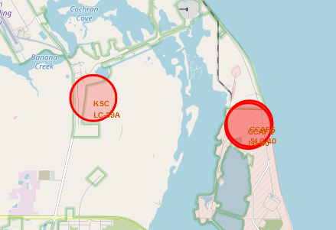
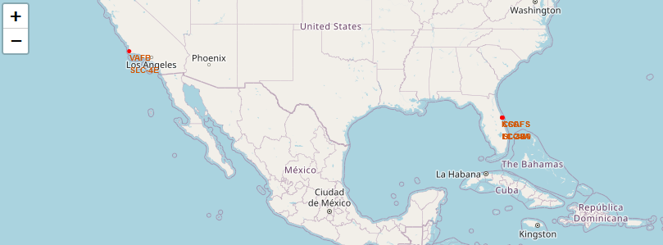
Results
Interactive analytics were used to study the launch sites and the surroundings
Most launches were near the equator and near coast lines

Slide 18
Results
Predictive analytics showed that the Decision Tree Classifier is the best model to predict successful landings
With an accuracy over 88%

Slide 19

Section 2

Slide 20
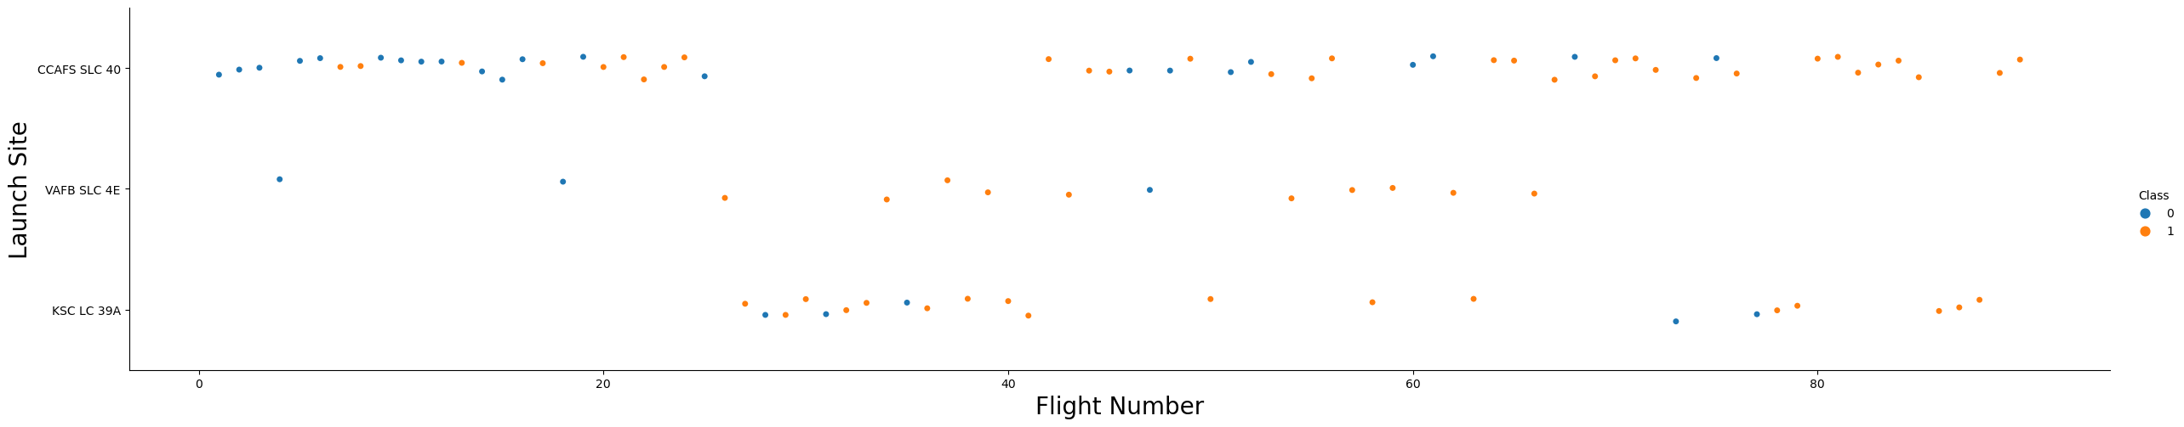
Flight Number vs. Launch Site
The scatter plot shows that the best launch site for recent launches is CCAF5 SLC 40
The plot also shows that the general success rate improved over time

Slide 21
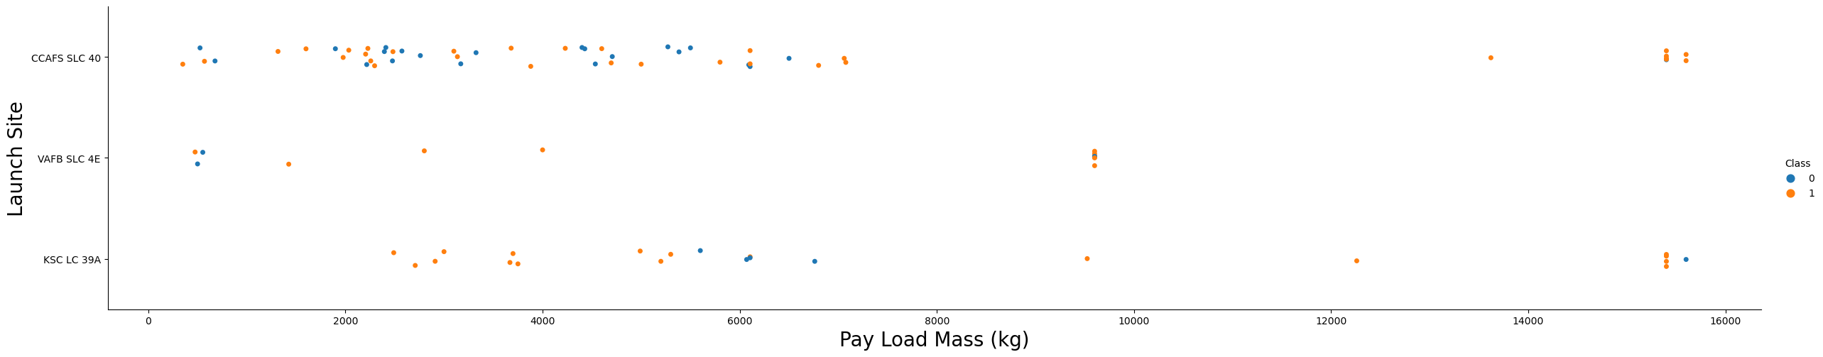
Payload vs. Launch Site
Payloads over 9000kg are often successful
No launches on VAFB-SLC over 10000kg

Slide 22
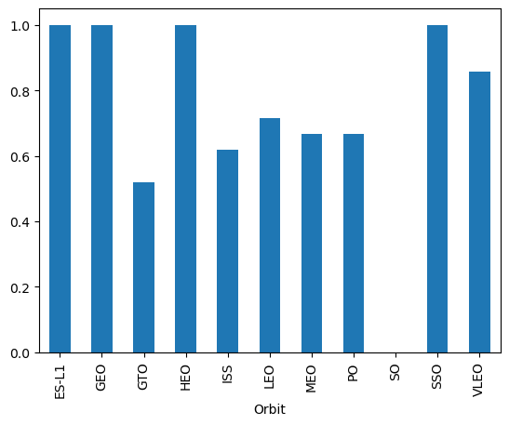
Success Rate vs. Orbit Type
Highest success for orbits:
ES-L1
GEO
HEO
SSO
Rank below:
VLEO
LFO

Slide 23
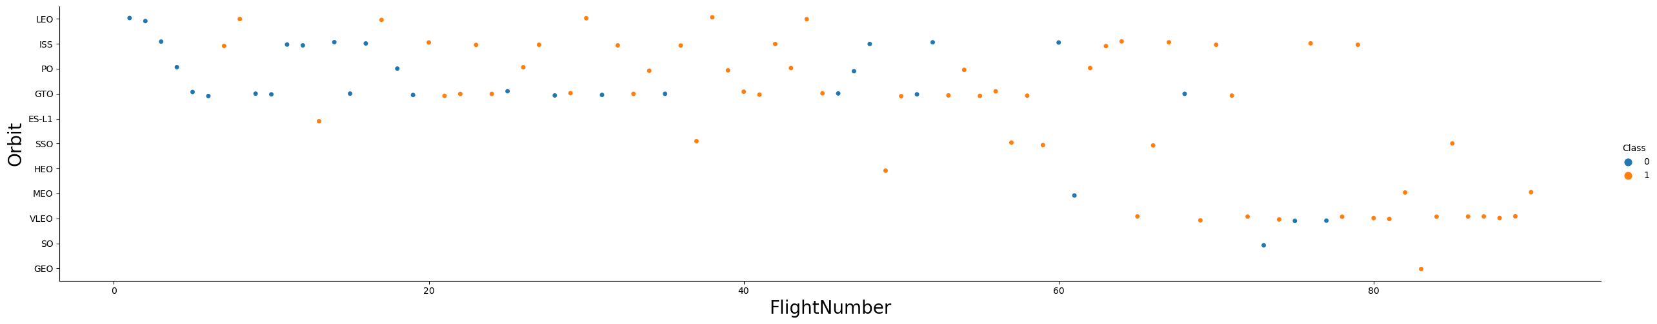
Flight Number vs. Orbit Type
Success rate improved over time
More launches to VLEO in recent history

Slide 24
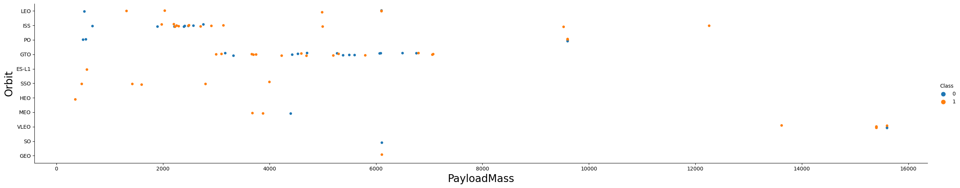
Payload vs. Orbit Type
No relations between payload and orbit type detected
Fewer launches to the heigher orbits

Slide 25
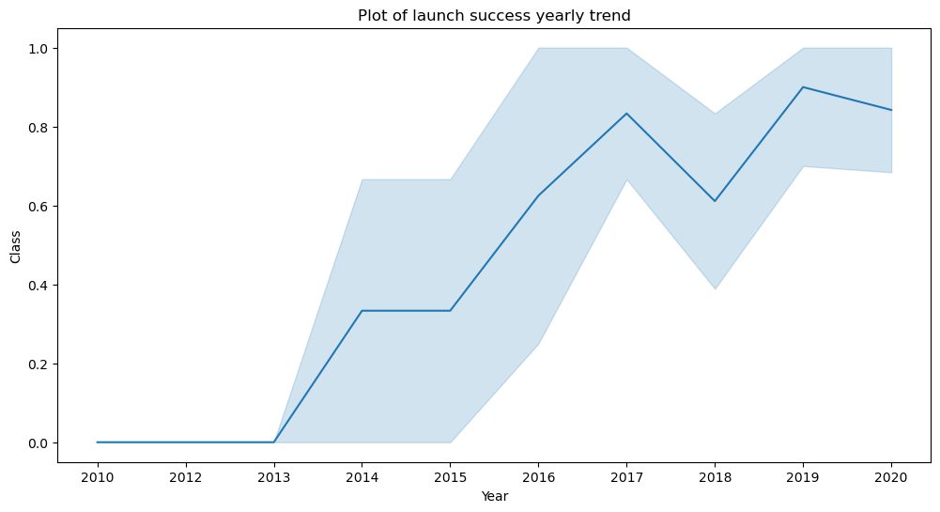
Launch Success Yearly Trend
Success rate increased beginning in year 2013 until 2020
First 3 years no successful launches

Slide 26
All Launch Site Names
In the dataset there were 4 different launch sites:
CCAFS LC-40
CCAFS SLC-40
KSC LC-39A
VAFB SLC-4E

Slide 27
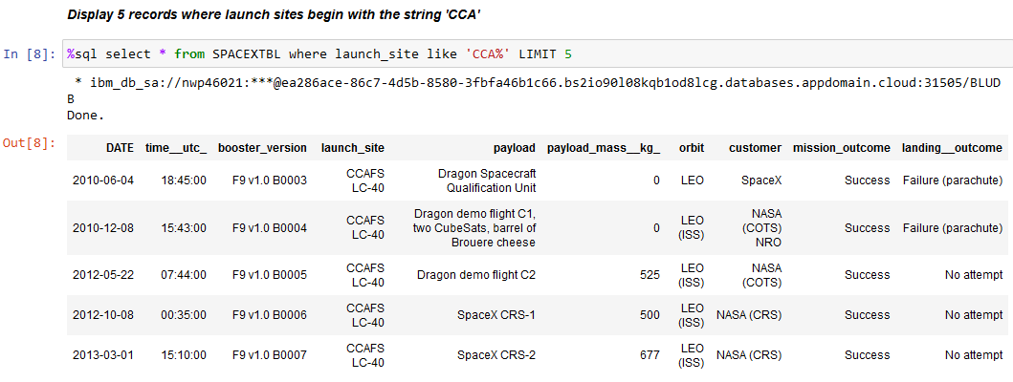
Launch Site Names Begin with 'CCA'
Find 5 records where launch sites begin with `CCA`
Query used LIMIT 5 to show 5 records

Slide 28
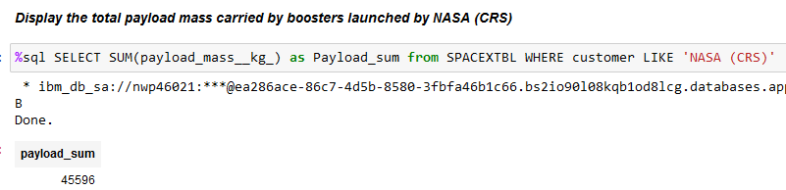
Total Payload Mass
Total payload carried by boosters from NASA
Query used the Sum function and the Like ‘string’ statement for calculation

Slide 29
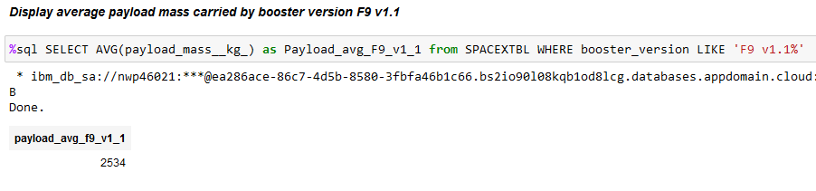
Average Payload Mass by F9 v1.1
Average payload mass carried by booster version F9 v1.1
Query used the average function and the like ‘string’ statement for calculation

Slide 30
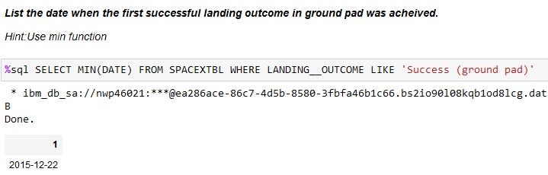
First Successful Ground Landing Date
Date of the first successful landing outcome on ground pad
Query used the min function and the like ‘string’ statement for calculation

Slide 31
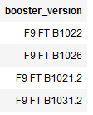
Successful Drone Ship Landing with Payload between 4000 and 6000
List the names of boosters which have successfully landed on drone ship and had payload mass greater than 4000 but less than 6000
SELECT BOOSTER_VERSION FROM SPACEXTBL WHERE LANDING__OUTCOME LIKE 'Success (drone ship)' AND payload_mass__kg_ BETWEEN 4000 AND 6000

Slide 32
Total Number of Successful and Failure Mission Outcomes
Calculate the total number of successful and failure mission outcomes:
71
Query used to count function
SELECT COUNT(LANDING__OUTCOME) FROM SPACEXTBL WHERE LANDING__OUTCOME LIKE 'Success%' OR LANDING__OUTCOME LIKE 'Failure%'

Slide 33
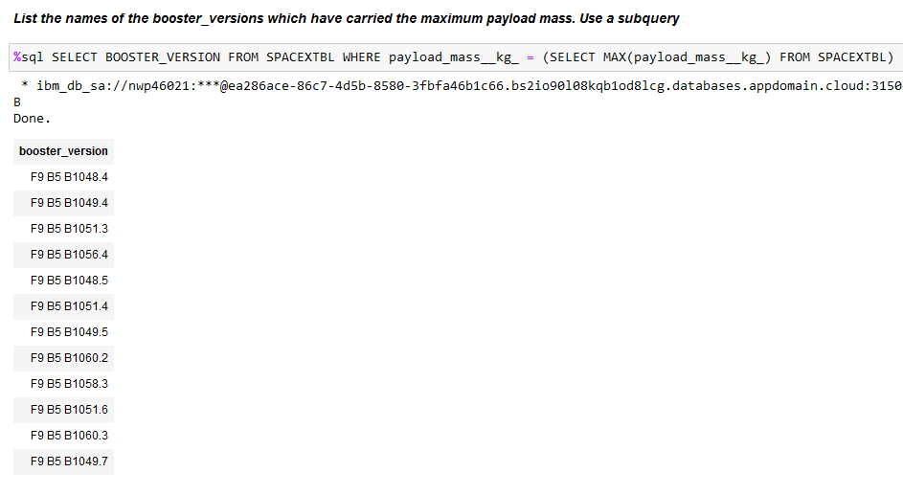
Boosters Carried Maximum Payload
List the names of the booster which have carried the maximum payload mass
Query used subquery

Slide 34
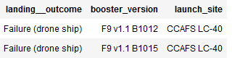
2015 Launch Records
List the failed landing_outcomes in drone ship, their booster versions, and launch site names for in year 2015
SELECT LANDING__OUTCOME, booster_version, launch_site FROM SPACEXTBL WHERE LANDING__OUTCOME LIKE 'Failure (drone_ship)' AND DATE LIKE '2015%'

Slide 35
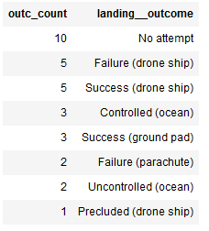
Rank Landing Outcomes Between 2010-06-04 and 2017-03-20
Rank the count of landing outcomes (such as Failure (drone ship) or Success (ground pad)) between the date 2010-06-04 and 2017-03-20, in descending order
SELECT COUNT(LANDING__OUTCOME) as outc_count, Landing__OUTCOME FROM SPACEXTBL WHERE DATE BETWEEN '2010-06-04' AND '2017-03-20' GROUP BY LANDING__OUTCOME ORDER BY outc_count DESC

Slide 36

Section 3

Slide 37
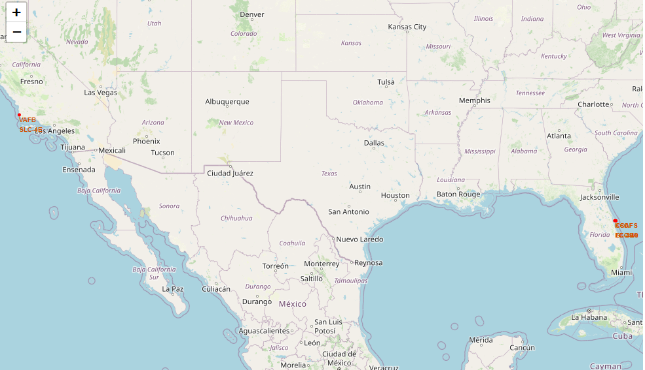
Launch Sites
Launch sites are near coast lines of the oceans and not too far from roads and railroads

Slide 38
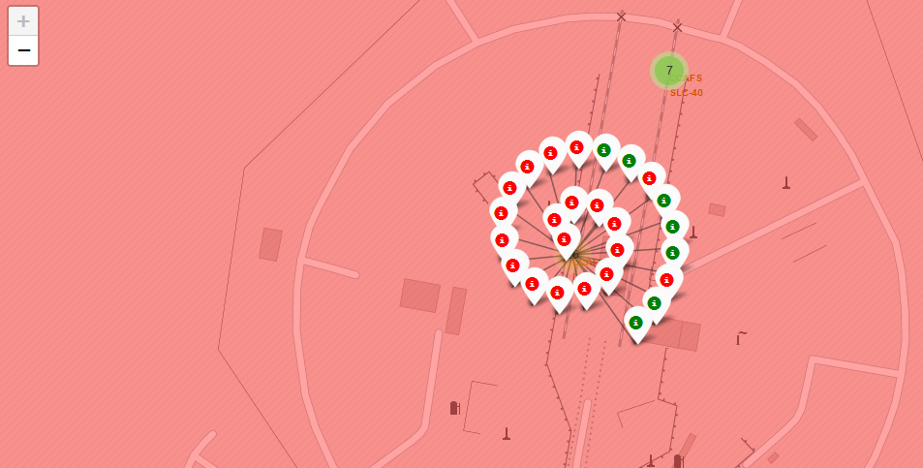
Launch outcomes
Colored markers indicate successful and failed launches

Slide 39
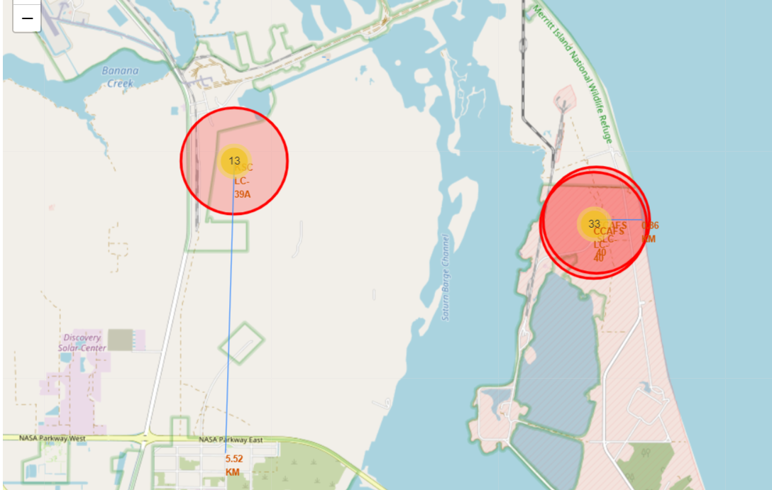
Launch sites area
Launch sites are near important logistic roads and railroads and far from populated areas

Slide 40

Section 4

Slide 41
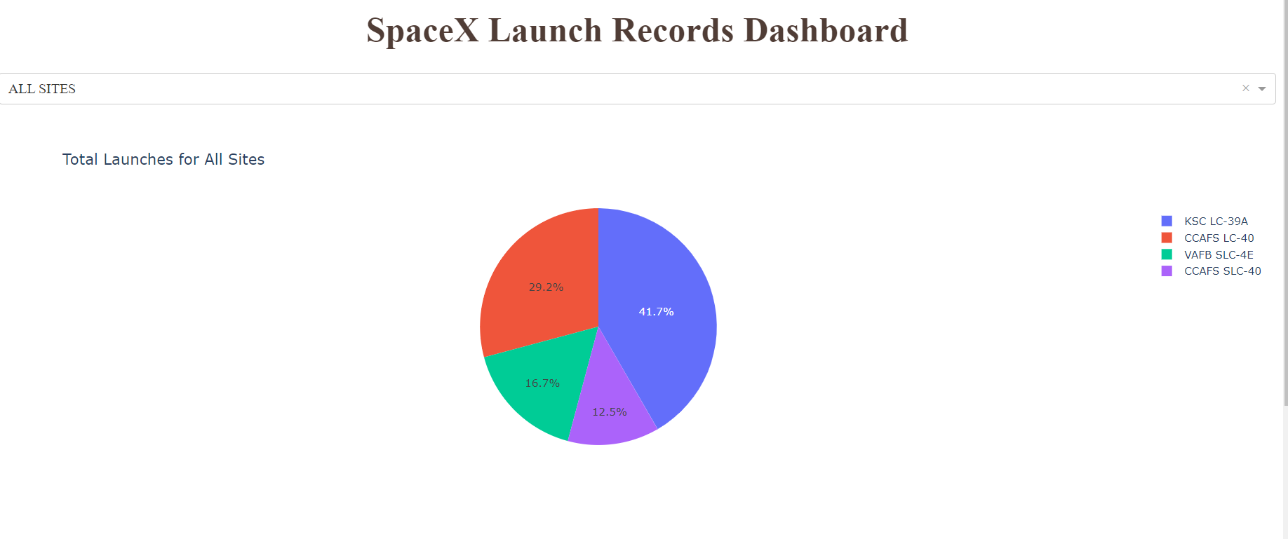
Successful Launches by Site
Pie chart for total success by launch site

Slide 42
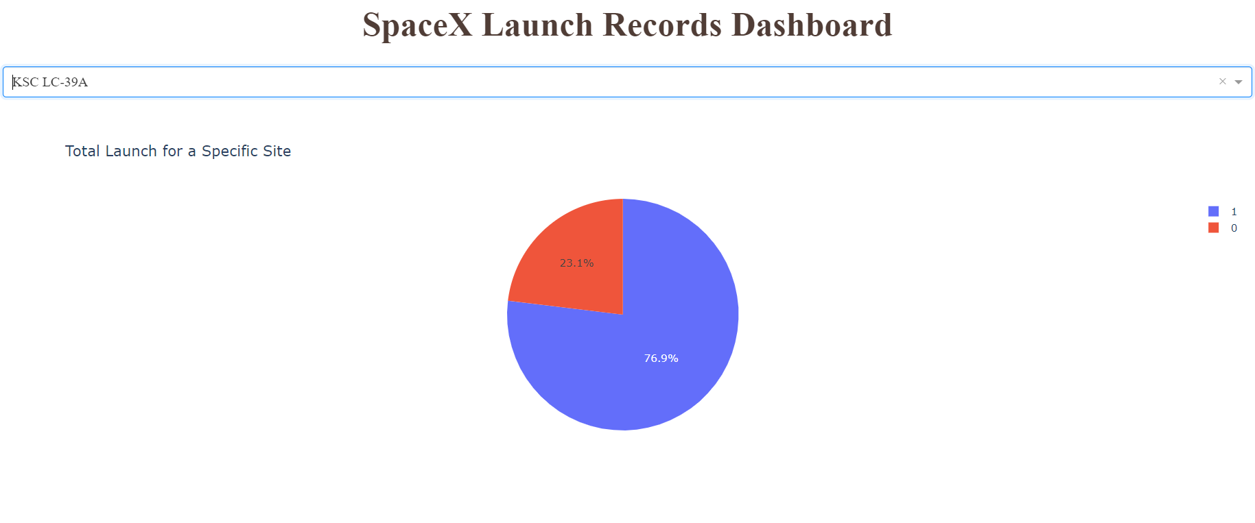
Launch success for KSC LC-39-A
KSC LC-39-A were the most successful launch site with 76.9% success rate

Slide 43
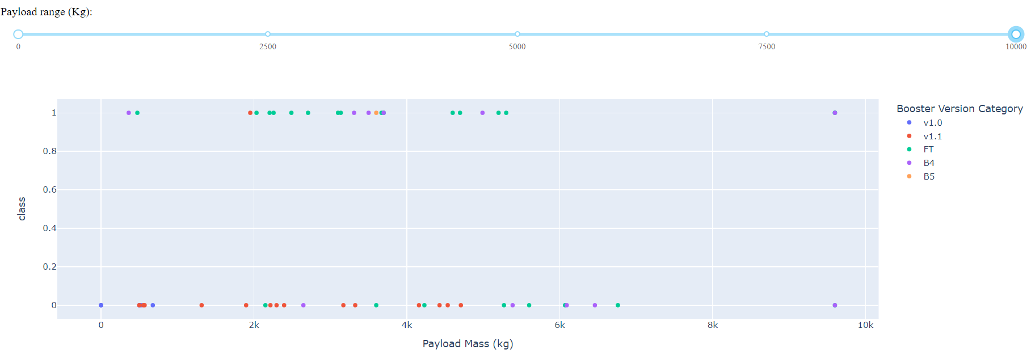
Payload vs. launch outcome
Payloads below 6000kg and FT boosters are most successful

Slide 44
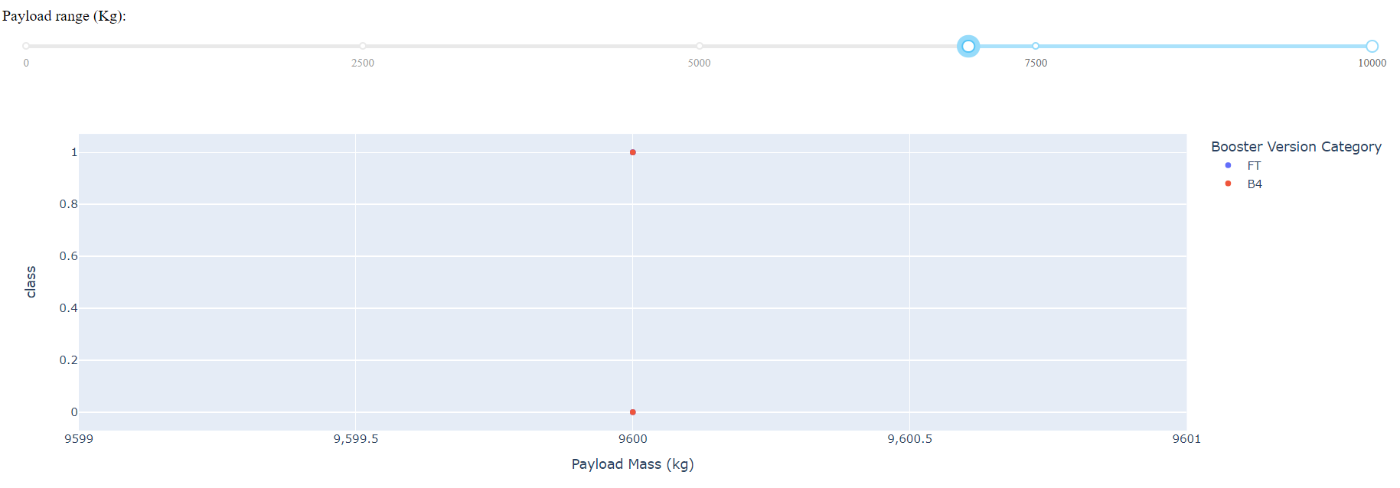
Payload vs. launch outcome
There’s not enough data for conclusions above 7000 kg

Slide 45

Section 5

Slide 46
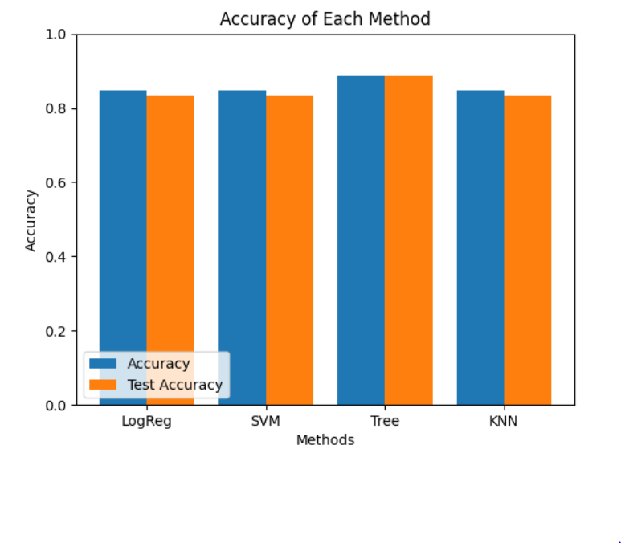
Classification Accuracy
The best model was the Decision tree classifier with an accuracy of 87%

Slide 47

Confusion Matrix Decision Tree
Confusion Matrix for the decision tree classifier

Slide 48
Conclusions
Best launch site is KSC-LC-39A
Success rate increased over the years
Launches above 7.000kg are more successful
Decision tree classifier is best suited to predict launch outcome

Slide 49
Appendix
All the important data can be found in GitHub Url:
https://github.com/Code770/IBM-Data-Science-capstone-project

Slide 50


